Slide 1
CommunityLife
Team Casa
Project Plan

Slide 2
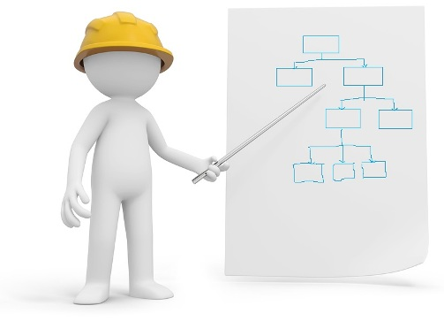
Work Breakdown
Each team member is assigned a task for the week
We have a master branch on Github
Each member has their own branch on Git
Code tested and iterated
Branches merge near end of the week
Merge conflicts will occur
Merge conflicts must be resolved
Code iterated and tested again

Slide 3

Work Allocation
Each of us will contribute to the coding
Each of us will contribute to the documentation
Adam will test our individual units of code and how they interact once merged
Tasks will be allocated in chronological order each week, with time sensitive tasks coming first.

Slide 4

Task Allocation Example
Task breakdown for next Friday:
Amy - Connect with Eventbrite API using Okhttp or Volley and collect and parse the necessary JSON data. (Android)
Cian - Local Device DB Design (Android & iOS)
Stephen - EventBrite API integration w/iOS & Firebase DB Design
Adam - Check everyone’s individual work of code, testing and making any corrections & communicate these back to team.

Slide 5
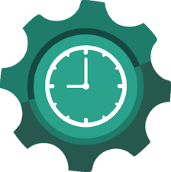

Time Schedule
Week 8: Previous slide
Week 9: UI Navigation, Starting with List view being fed by Eventbrite API, Login & Favourite Event Functionality (all tested!)
Week 10: Listview of favourite events, GPS, Calendar & Inhouse event creation.
Week 11: Final UI brush up, make sure navigation between pages is intuitive and comprehensible. Documentation must be complete.

Slide 6



Milestones
Successfully retrieve and implement JSON data.
Database system implemented (Firebase & Local DB)
Event ListView based on GPS
Event Notifications w/ Calendar integration
UI conforming to design documentation
Final documentation

Slide 7
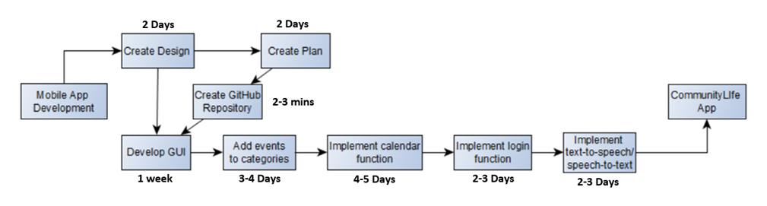
Critical Path / Sequence of Activities

Slide 8
Critical Path / Sequence of Activities
Approximately 5 days completed.
Completed design and planning documents.
GitHub repository set up and linked to Android Studio.
Current works on Graphical User Interface.
Future works on functionality & data structure.
Approximately 24 days in total.

Slide 9
Risks

Slide 10

Risk Register
We have Android Studio/ Xcode for identifying many risks in relation to the code.
We have devised a risk register containing the risk’s description, it’s likelihood/probability, the impact of the risk and how we might prevent it.
This will help us make less errors and less amount of times needed to iterate… hopefully!

Slide 11
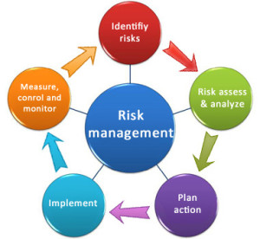
Risk Management
If we suspect a risk, we will:
Identify the risk
Analyse the risk
Treat the risk
Monitor and Review the risk

Slide 12

Summary
We have a clear plan of our project plan over the next four weeks
Coding tasks are divided up and tested
Coding tasks are combined and tested
Any adjustments to the codes functionality and it will be iterated until it is satisfiable
Approximate activity completion times.
Risks can be managed easily if identified early

